Slide 1

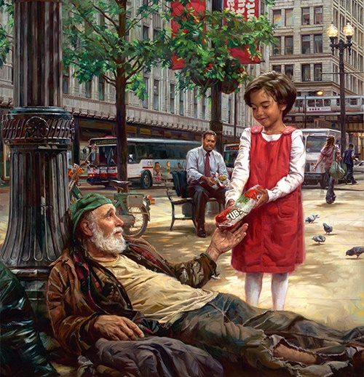
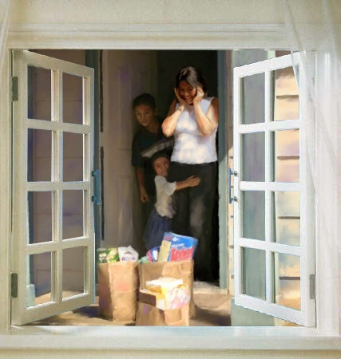
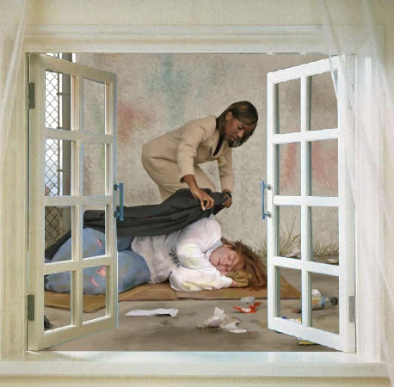
KAMWOKYA SDA CHURCH

Slide 2

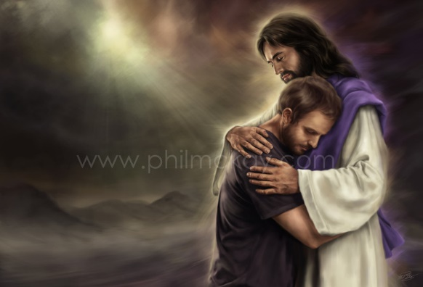
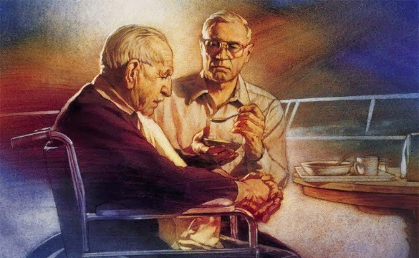

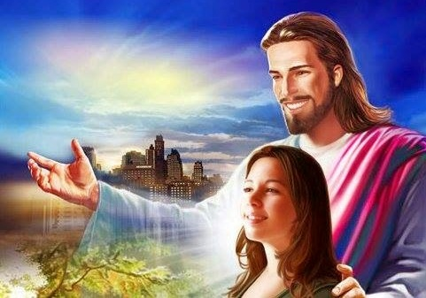
KAMWOKYA SDA CHURCH
OKWESIGA KATONDA
ISAAYA 40:30-31
ZABBULI 46:01-03
YEREMIYA 17:7-8

Slide 3

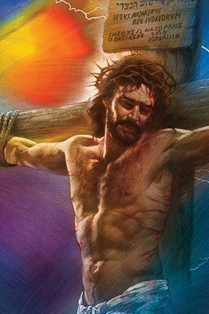
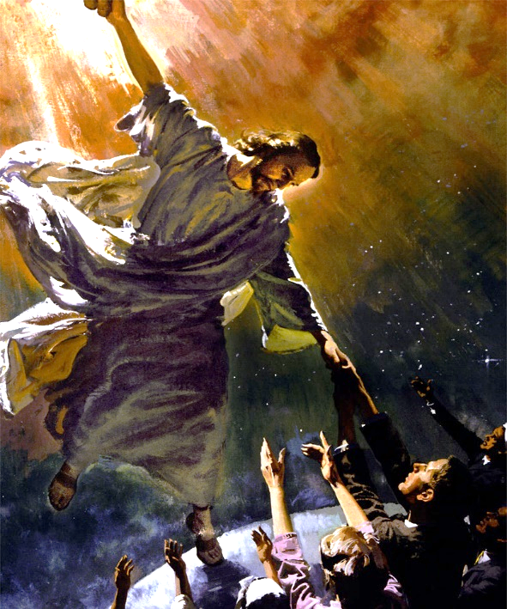
OKWESIGA KATONDA

Slide 4

“Salvation is a free gift, and yet it is to be bought and sold. In the market of which divine mercy has the management, the precious pearl is represented as being bought without money and without price. In this market all may obtain the goods of heaven […]
The gospel of Christ is a blessing that all may possess. The poorest are as well able as the richest to purchase salvation; for no amount of worldly wealth can secure it. It is obtained by willing obedience, by giving ourselves to Christ as His own purchased possession.”
E.G.W. (Christ’s Object Lessons, cp. 9, p. 116-117)

Slide 5

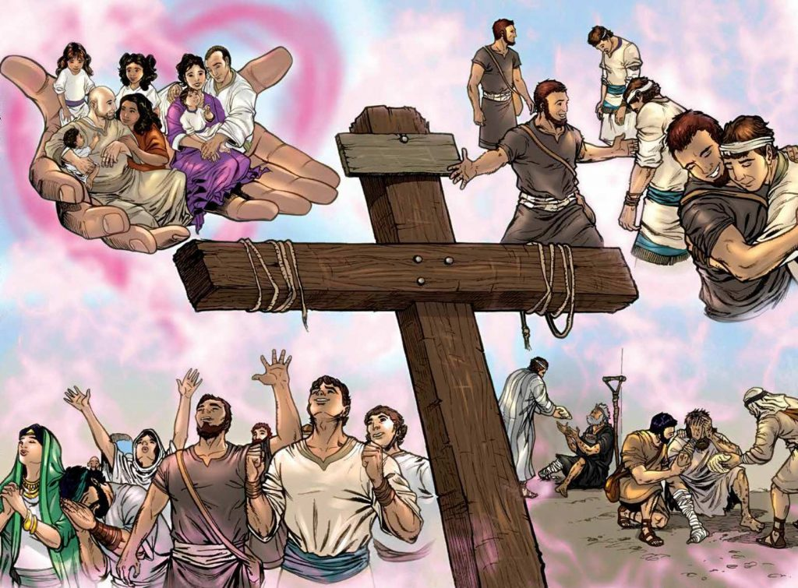
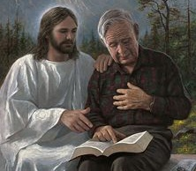
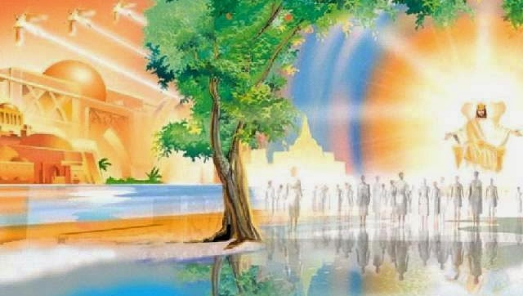
BEYOND OUR UNDERSTANDING
“For as the heavens are higher than the earth, so are My ways higher than your ways, and My thoughts than your thoughts.” (Isaiah 55:9)
Our minds cannot understand the mystery of salvation. It can only be understood in a spiritual way (1Co. 2:14). Therefore, God gives us the necessary knowledge to understand it (1Tim. 2:3-4).
This knowledge grows as our daily relationship with Christ does (Col. 1:10; 2P. 3:18). However, we will never understand it to the fullest. We will keep studying the plan of redemption for all eternity.
“The theme of redemption is one that angels desire to look into; it will be the science and the song of the redeemed throughout the ceaseless ages of eternity. Is it not worthy of careful thought and study now?” (E.G.W., “My Life Today”, p. 360).

Slide 6

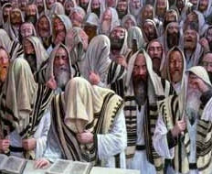
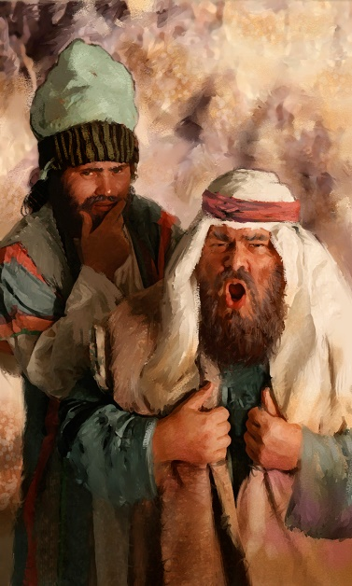
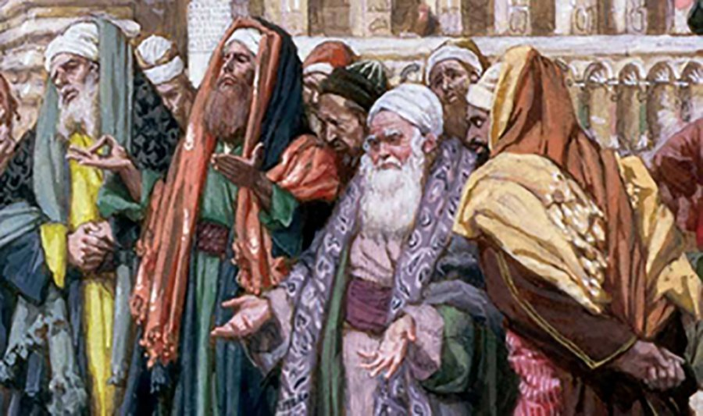
FASTING THAT DISPLEASES GOD
“Is it a fast that I have chosen, a day for a man to afflict his soul? Is it to bow down his head like a bulrush, and to spread out sackcloth and ashes? Would you call this a fast, and an acceptable day to the Lord?” (Isaiah 58:5)
The Day of Atonement was the only fasting day that God had ordered. That is why it was called “the Fast” (Acts 27: 9). People added other daily or week fasting days later. Those were not required by God, and He didn’t sanction them (Zech. 7:3-10).
The Israelites expected God to approve their fasting (Is. 58:3). However, God’s responded in an unexpected way: “You will not fast as you do this day, to make your voice heard on high.” (v. 4)
They were trying to soften God’s heart with their “religiousness” in order to buy forgiveness. God was not requesting that at all.

Slide 7

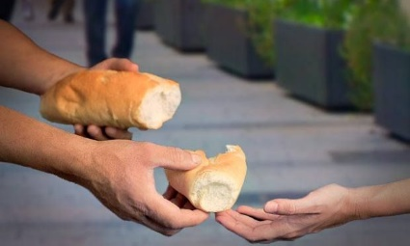
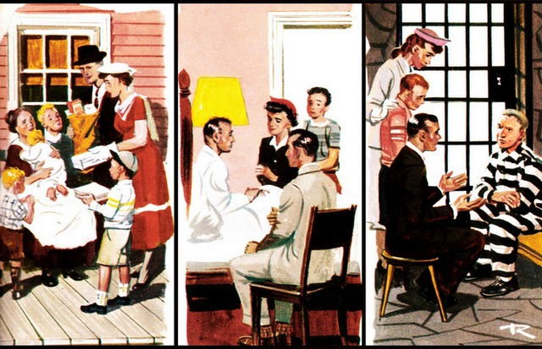

FASTING THAT PLEASES GOD
“Is it not to share your bread with the hungry, and that you bring to your house the poor who are cast out; when you see the naked, that you cover him, and not hide yourself from your own flesh?” (Isaiah 58:7)
The things that please God are not related to refraining from eating for some time. He is pleased when we share what we have, and care for others. This is a lifestyle, not a one-time act.
Our fasting pleases God only if we are already showing His love to others in our daily life. Then, He guides us, satisfies our soul, and strengthens us (Isaiah 58:11).
“Pure and undefiled religion before God and the Father is this: to visit orphans and widows in their trouble, and to keep oneself unspotted from the world.” (James 1:27).

Slide 8

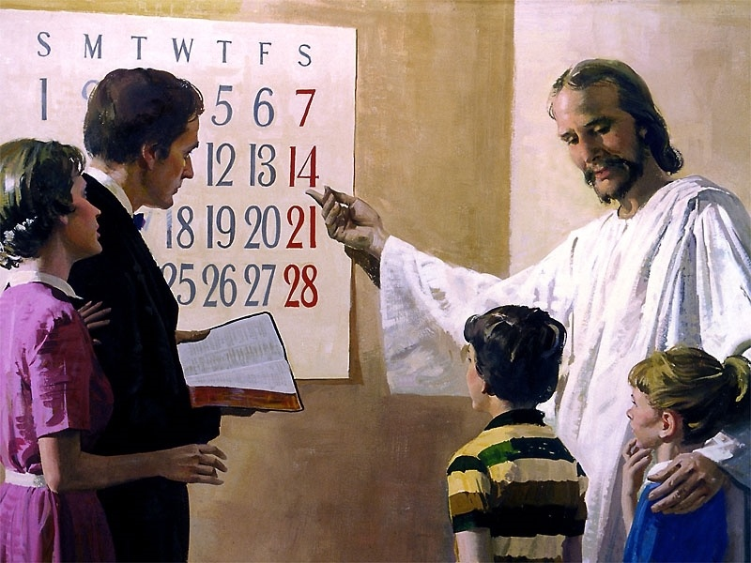
DELIGHTING IN GOD
“If you turn away your foot from the Sabbath, from doing your pleasure on My holy day, and call the Sabbath a delight, the holy day of the Lord honorable, and shall honor Him, not doing your own ways, nor finding your own pleasure, nor speaking your own words, then you shall delight yourself in the Lord; and I will cause you to ride on the high hills of the earth, and feed you with the heritage of Jacob your father. The mouth of the Lord has spoken.” (Isaiah 58:13-14)
How are afflicting the soul, helping others, and keeping the Sabbath related?
All three involve concentration upon God, His priorities, and recognition of our dependence upon Him.
By doing all three, we pursue holiness by emulating God, who humbled Himself (Philippians 2:8), demonstrated self-sacrificing kindness (Acts 10:38), and ceased from labor on the Sabbath (Genesis 2:2-3).
Besides being a delight, keeping the Sabbath also brings special blessings (v. 14).

Slide 9

“Good deeds are twice a blessing, benefiting both the giver and the receiver of the kindness. The consciousness of right-doing is one of the best medicines for diseased bodies and minds. When the mind is free and happy from a sense of duty well done and the satisfaction of giving happiness to others, the cheering, uplifting influence brings new life to the whole being.”
E.G.W. (The Ministry of Healing, cp. 18, p. 257)

